Slide 1
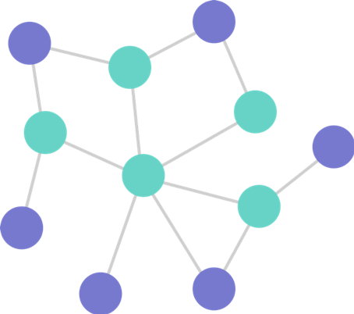
Counting number of paths of length n in a Graph
Hossam Ahmed 222695

Slide 2
PROBLEM
Given a graph G with V vertices and E edges, we want to count the number of paths of length n between any two vertices.

Slide 3
STRATEGY
Problem Reduction. If you need to solve a problem, reduce it to another problem that you know how to solve.
How will we use this strategy
to solve our problem ?

Slide 4
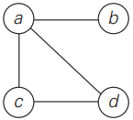
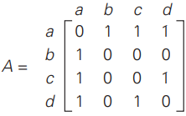
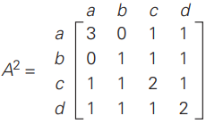
ALGORITHM
Represent the graph G as an adjacency matrix A of size V × V.
A[ i ][ j ] will be the number of edges from vertex i to vertex j.
Raise the adjacency matrix A to the power of
2 using matrix multiplication techniques.
The resulted matrix A² represents the number of paths of length 2 from vertex i to vertex j in the graph.

Slide 5
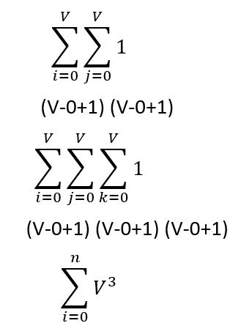
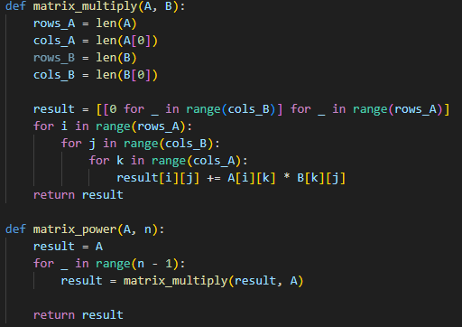
Implementation and Time Complexity Analysis

Slide 6
THANKS FOR LISTENING!

